Slide 1

Neural Network Regression
Supervised By
Damir Dobric
Presented By,
Md.Toufiq Zaman
Matric.No: 1232699
Master‘s in Information Technology
Software Engineering

Slide 2
Contents
What is Neural Network?
A Typical Neuron vs Artificial Neuron
What is Regression?
Types of Regression
Using Neural Network with Regression
Training the network
Reference

Slide 3
What is Neural Network?
Neural Network is a machine learning technique or algorithm that try to mimic the working of neuron in human brain for learning. The brain is a highly complex, non-linear and parallel computer or an information-processing system. It has the capability to organize its structural constituents, known as neurons, so as to perform certain computations like pattern recognition, perception and motor control, many times faster than the fastest digital computer in existence today.

Slide 4
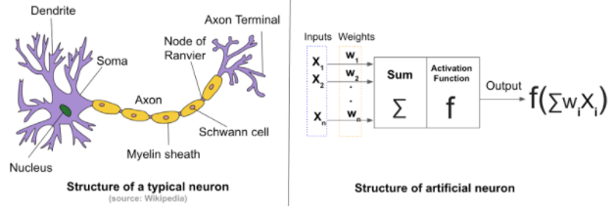
A typical Neuron vs Artificial Neuron

Slide 5
What is Regression?
Regression analysis is a form of predictive modelling technique which investigates the relationship between a dependent (target) nd independent variable (s) (predictor).
This technique is used for forecasting, time series modelling and finding the causal effect relationship between the variables.

Slide 6
Types of Regression
The truth is that there are innumerable forms of regressions, which can be performed. Each form has its own importance and a specific condition where they are best suited to apply. Some prominent names are provided below:
Linear Regression
Logistic Regression
Polynomial Regression
Stepwise Regression
Ridge Regression
Lasso Regression
ElasticNet Regression
Time Series Regression

Slide 7
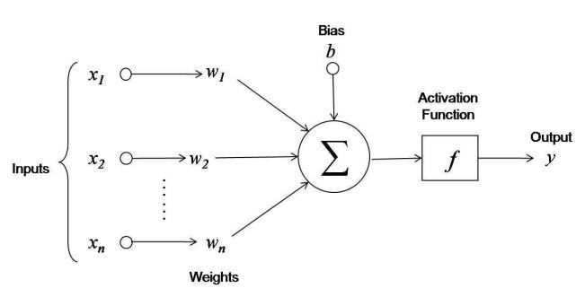
Using Neural Network with Regression

Slide 8
Training the Neural Network
Forward propagation
An input vector propagates through the network
2. Weight update (backpropagation)
the weights of the network will be changed in order to decrease the difference between the predicted and gold standard values
* We used back-propagation algorithm here because Back propagation is an iterative process in which values of the weights and biases slowly change, so that the NN usually computes more accurate output values.

Slide 9
Unit Test
5 unit tests are used:
1. TestByData
2. TestWithMaxIteration
3. TestWithCSVData
4. TestWithMaxLearningRate
5. TestWithMinIteration

Slide 10
References
[1] Symon haykin, “Neural Networks,” A comprehensive Foundation, 2nd Edition, 2005.
[2] Neural Network regression [online], Available: https://msdn.microsoft.com/en-us/magazine/mt683800.aspx [Accessed 2019]
[3] Getting Started with Neural Network for Regression [online], Available: https://medium.com/@rajatgupta310198/getting-started-with-neural-network-for-regression-and-tensorflow-58ad3bd75223 [Accessed 2019]
[4]A beginners Guide to Neural Network and Deep Learning [online], Available: https://skymind.ai/wiki/neural-network [Accessed 2019]
[5] Christos Stergiou and Dimitrios Siganos, “Neural Networks”, vol4, cs11
[6] O. Source, "UniversityOfAppliedSciencesFrankfurt/LearningApi: Machine Learning foundation on top of .NET Core," 2019. [Online]. Available: https://github.com/UniversityOfAppliedSciencesFrankfurt/LearningApi. [Accessed 2019].

Slide 11


